Slide 1
Classical Multi-factor Models
This slide set is largely based on Ang Chapter 7

Slide 2
CAPM Recapped
In the CAPM there is only one market factor (risk)
Holding company-specific risk leads to lower expected total wealth and can be diversified away.
All stocks carry market risk exposure (few assets have zero exposure).
Assets are simply vehicles to earn the market risk premium and are bundles of market risk (which has a positive expected return) and idiosyncratic risk (which doesn’t earn any risk premium).

Slide 3
CAPM in Bad Times
Another way to view the CAPM is from the viewpoint of what determines expected excess returns:
A stock with a high beta has a high expected return because its large comovement (covariance, or beta) with the market makes it risky, so investors require a premium for holding it. Conversely, stocks with low betas pay off when the market declines (high correlation with negative market moves). These stocks are valuable so they do not need high expected returns to induce investors to hold them.
The risk premium compensates for covarying with “bad” times, defined by low returns of the market portfolio. High covariances with r_{m} = high beta => high risk premiums
Notes:
Use a two-security example to illustrate, that pay off, respectively, in good and bad states.

Slide 4
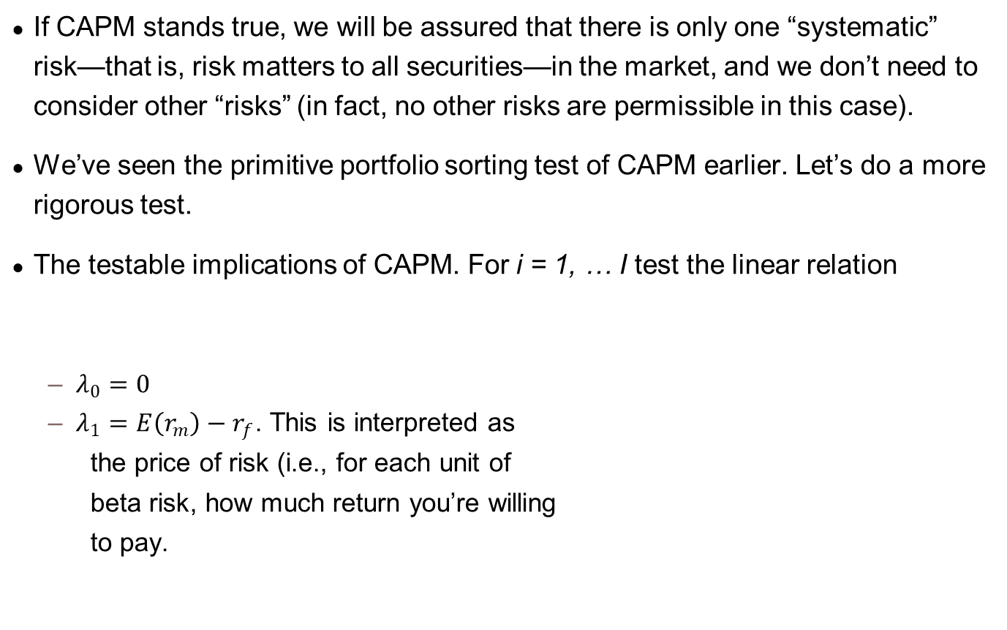
Is CAPM good enough?
If CAPM stands true, we will be assured that there is only one “systematic” risk—that is, risk matters to all securities—in the market, and we don’t need to consider other “risks” (in fact, no other risks are permissible in this case).
We’ve seen the primitive portfolio sorting test of CAPM earlier. Let’s do a more rigorous test.
The testable implications of CAPM. For i = 1, … I test the linear relation
$λ_{0}=0$
$λ_{1}=E\left(r_{m}\right)−r_{f}$. This is interpreted as
the price of risk (i.e., for each unit of
beta risk, how much return you’re willing
to pay.

Slide 5
Testing assets
Testing assets
Individual stocks: individual stocks tend to be noisy
Form portfolios to reduce noise

Slide 6
Exercise 1
Continue with your data work on 100 Nasdaq stocks.
You already estimated the beta value of the 100 stocks as of Dec. 2019. Test if CAPM holds for Dec. 2019 for these individual stocks.
To reduce noises from using individual stocks, you should consider using portfolios. You also formed decile portfolios of the 100 stocks. Re-test CAPM of your decile portfolio series, for Dec. 2019.
This is the classical Fama-MacBeth (1973) approach.
Often described as “two-stage” (or “two-pass”) or cross-sectional test in standard textbooks.
First pass: estimate asset beta’s
Second pass: Test SML.

Slide 7
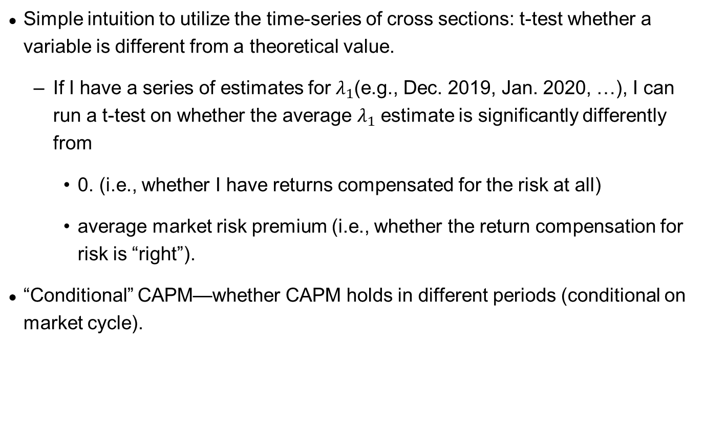
Utilizing the time-series of asset cross sections
Simple intuition to utilize the time-series of cross sections: t-test whether a variable is different from a theoretical value.
If I have a series of estimates for $λ_{1}$(e.g., Dec. 2019, Jan. 2020, …), I can run a t-test on whether the average $λ_{1}$ estimate is significantly differently from
0. (i.e., whether I have returns compensated for the risk at all)
average market risk premium (i.e., whether the return compensation for risk is “right”).
“Conditional” CAPM—whether CAPM holds in different periods (conditional on market cycle).

Slide 8
Exercise 1.2
Use decile portfolios of the 100 stocks of your entire sample period. Re-test CAPM.

Slide 9
Testing portfolios used in the literature
Fama and French have many portfolios that are widely used.
Check Ken French’s data library: https://mba.tuck.dartmouth.edu/pages/faculty/ken.french/data_library.html
Fama-French 25 size and book-to-market double-sorted portfolios are one of the most frequently used portfolios.

Slide 10
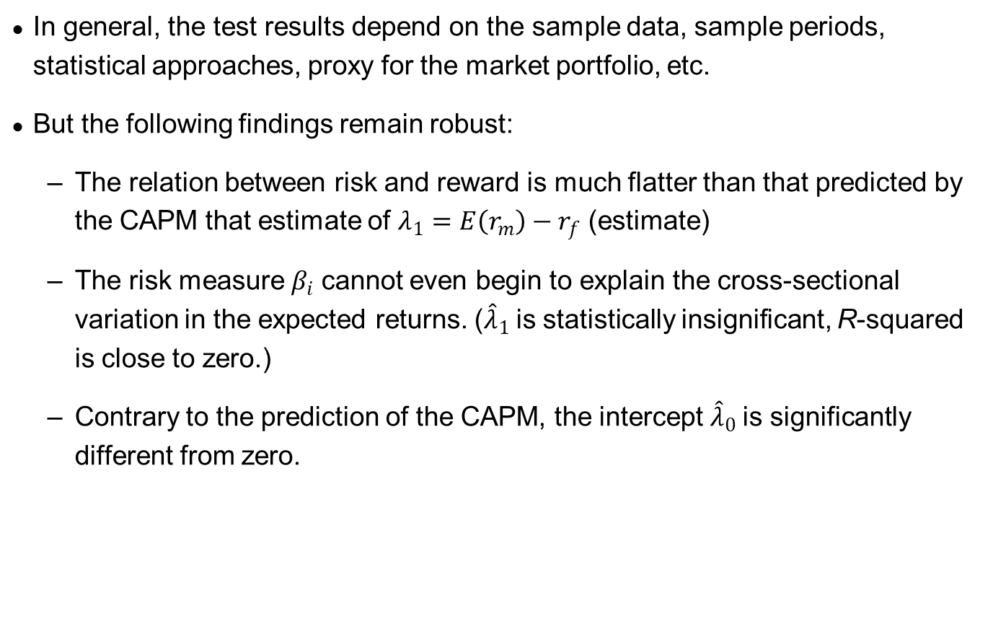
A Summary of the CAPM Tests
In general, the test results depend on the sample data, sample periods, statistical approaches, proxy for the market portfolio, etc.
But the following findings remain robust:
The relation between risk and reward is much flatter than that predicted by the CAPM that estimate of $λ_{1}=E\left(r_{m}\right)−r_{f}$ (estimate)
The risk measure $β_{i}$ cannot even begin to explain the cross-sectional variation in the expected returns. (${\hat{λ}}_{1}$is statistically insignificant, R-squared is close to zero.)
Contrary to the prediction of the CAPM, the intercept ${\hat{λ}}_{0}$is significantly different from zero.

Slide 11
Multifactor Asset Pricing Models
The empirical failure of CAPM leaves room for improvement
A multifactor model can represent, for a universe of assets, multiple sources of (i) common variation in realized returns; or equivalently, (ii) risk premia present in expected returns

Slide 12
Moving to a Multifactor World
Suppose investors care about bad times defined by more than just low market returns, e.g. times of low liquidity (the risk that when you want to sell nobody wants to buy at a “decent” price). These are times of “high marginal utility”.
The extra liquidity risk must affect the average investor (remember the average investor holds the market). Investors cannot just transfer liquidity risk between themselves; investors must collectively care about liquidity risk and bid down prices of assets exposed to liquidity risk.
Assets with high exposure (high betas) to liquidity risk earn high returns. These assets have low payoffs during illiquid times and require high returns to compensate the average investor for holding them.
Notes:
Low payoffs during illiquid times = high liquidity risk

Slide 13
Multifactor Model
The multifactor model for excess returns:
Assets with high betas have high expected returns, assuming the factor risk premium > 0, because the high risk premiums compensate investors for bearing losses during adverse times
In general factor premiums can be positive or negative
Positive risk premium: the average investor doesn’t like exposure
Negative risk premium: the average investor likes the exposure

Slide 14
Factors Drive Returns
The ultimate driver of returns is the factor structure. Assets allow investors to access risk premiums because assets are exposed to factor risk. Assets are “means to an end”.
Put another way, you don’t earn a risk premium for holding a particular asset class, e.g. the auto industry, US equities/corporates, etc. Asset classes earn risk premiums only because they have underlying factor exposures. Assets are conduits for factor risk.

Slide 15
Properties of Ideal Factors
Impeccably justified by credible academic literature with either rational or behavioral theory
Have exhibited significant risk premiums in the past and are expected to persist in the future
Return history during “bad periods” is available for risk management and for calibrating risk aversion.

Slide 16
Classical Multifactor Models
Two classical multifactor models
Macroeconomic and financial variables: Chen, Roll, and Ross (1986)
Fama and French (1993) return spreads between portfolios formed according to cross-sectional sorts

Slide 17
Chen, Roll and Ross (1986)
The survey conducted by Graham and Harvey (2001) shows that CFOs consider primarily macroeconomic risks in cost of capital calculations
The overall goal is to identify a set of macroeconomic factors associated with returns on financial assets
Chen, Roll, and Ross view an asset’s price as the present value of discounted future cash flows, and hence
factors affecting price changes (or asset returns) are factors related to changes in expected cash flows or changes in discount rates

Slide 18
Chen, Roll and Ross (1986)
This reasoning leads to five factors:
IP: monthly growth rate of industrial production
EI: change in expected inflation—changes in short-term T-bill rate
UI: unexpected inflation—the difference between actual and expected inflation
CG: unexpected changes in risk premium—the difference between the returns on corporate Baa bonds and long-term governance bonds
GB: unexpected changes in the term premium—the difference between the returns on long- and short-term governance bonds
The returns on the equally weighted portfolio (EWNY) or the value weighted portfolio (VWNY) of NYSE included as the sixth factor
This nests CAPM.

Slide 19
Chen, Roll and Ross (1986)
This reasoning leads to five factors:
IP: monthly growth rate of industrial production
EI: change in expected inflation—changes in short-term T-bill rate
UI: unexpected inflation—the difference between actual and expected inflation
CG: unexpected changes in risk premium—the difference between the returns on corporate Baa bonds and long-term governance bonds
GB: unexpected changes in the term premium—the difference between the returns on long- and short-term governance bonds
The returns on the equally weighted portfolio (EWNY) or the value weighted portfolio (VWNY) of NYSE included as the sixth factor
This nests CAPM.

Slide 20
Chen, Roll and Ross (1986)
Two-stage regressions, 20 size portfolios as the testing assets
Significant factors: industrial production, risk premium on bonds, and unanticipated inflation
Market returns are not statistically significant in the multifactor tests

Slide 21
Fama-French factors
In explaining the cross-sectional variations of average returns, beta does not seem to be enough; size and book-to-market dominate beta.

Slide 22
Fama-French
Fama and French (1993)
Includes a small and value factor in addition to the market factor (MKT)
SMB = Returns on the portfolio of small minus big stocks
HML = Returns on the portfolio of high book/price (value) minus low book/price (growth)
Fama and French interpret the small stock effect and the value effect as being systematic factors.
SMB and HML are zero-cost portfolios, so β_{i,SMB} and β_{i,HML} are centered around zero
Extension of CAPM to size effect and value effect

Slide 23
FF Factors: Value vs Growth
Value Stocks: “Stocks that are out of favor with the investment community selling at relatively low prices in relation to their earnings or book value. These stocks typically produce above-average dividend income.”
Growth Stocks: “Stocks of companies with above-average prospects for growth based on measures like revenue, earnings and book value. These stocks generally produce little dividend income and tend to trade at high prices relative to earnings or book value.”
The SMB and HML factors are zero cost:
SMB = $1 in small stocks minus $1 in large stocks
HML = $1 in value stocks minus $1 in growth stocks
A fund manager “specializing” in small stocks has a positive loading on SMB, and a fund manager tilting towards value stocks has a positive loading on HML

Slide 24
FF Factor Construction
At each point of time, sort all firms independently into two size groups (S and B) and three book-to-market groups (L, M, and H)
Form six value-weighted portfolios, LS, MS, HS, LB, MB, and HB, as the intersections of the size and book-to-market groups
HML is constructed to be neutral with respect to size:
HML = (HS + HB)/2 − (LS + LB)/2
SMB is constructed to be neutral with respect to book-to-market:
SMB = (HS + MS + LS)/3 − (HB + MB + LB)/3

Slide 25
Multifactor test implementation
Same two-stage regressions
First stage, estimate factor loadings (i.e., beta’s) from the following multivariate regression for each asset i:
Second stage, OLS (for this course) test on whether each beta is significantly priced (i.e., lambda’s significantly different from zero):
where E(*) is the average return over the period.
$$r_{i,t}−r_{f,t}=α_{i}+β_{i,MKT}\left(r_{m,t}−r_{f,t}\right)+β_{i,SMB}{SMB}_{t}+β_{i,HML}HML_{t}+ε_{i,t}$$
$$E\left[r_{i,t}\right]−{E(r}_{f})=α+λ_{1}β_{i,MKT}+λ_{2}β_{i,SMB}+λ_{1}β_{i,HML}+ε$$

Slide 26
FF 3-Factor Evidence
Test assets: Fama-French 25 size and book-to-market double-sorted portfolios

Slide 27
Expansion of the original FF 3 factors
A common addition is a long-short momentum factor UMD or MOM originally due to Carhart (1997)
Momentum Premium = Winning stocks minus losing stocks
FF-3 factor model does not explain momentum profits.
MKT, SMB, HML and MOM sometimes referred to as FF-4 factors for convenience.

Slide 28
What kinds of economic risks does a FF factor represent?
Any rational story of a strategy having unconditionally high expected returns is those high expected returns compensate the investor for losing money during bad times.
Applied to HML:
Value stocks have high expected returns because they are risky during bad times. Value stocks tend to lose money during bad times and require high risk premia to induce investors to hold these stocks.
Growth stocks have low returns because they tend to pay off during bad times and are less risky.

Slide 29
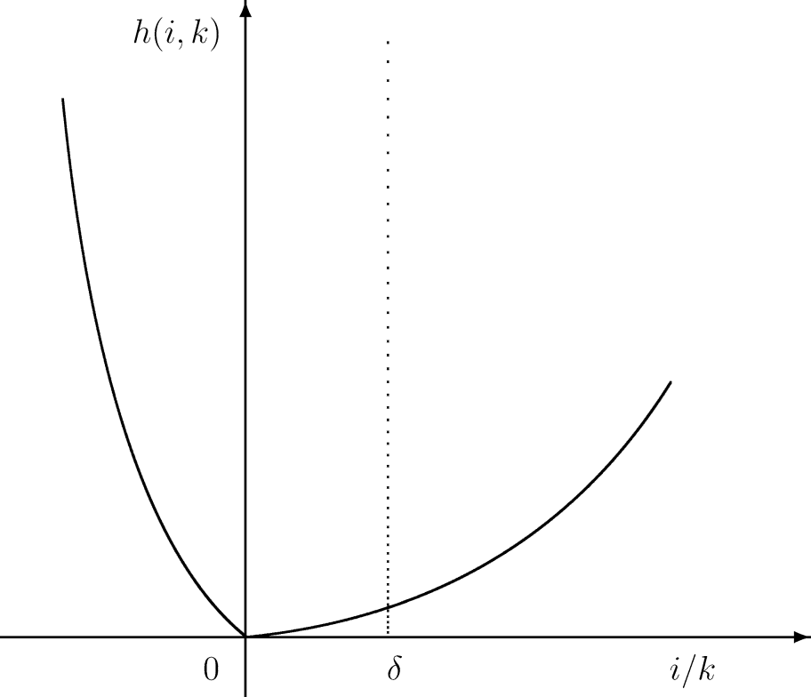
Real Investment Risk
In Zhang (2005), adjustment costs are asymmetric and firms face higher costs in adjusting capital stocks downward
Value firms are risky because during bad times
They are burdened with more unproductive capital (they cannot disinvest as easily as growth firms because they hold stodgy PP&E).
They want to cut back on capital, face higher adjustment costs
Thus they are riskier than growth firms
Growth firms can better deal with a downturn by deferring investment
Figure 1 from Zhang (2005)

Slide 30
Exercise 2
Download FF Factors (SMB, HML, MOM) from WRDS. Plot the return distribution of these. Are they different from zero?
Plot the cumulative returns of $1 investing in SMB.
Repeat Exercise 1 for FF-3 Factors.

